Slide 1
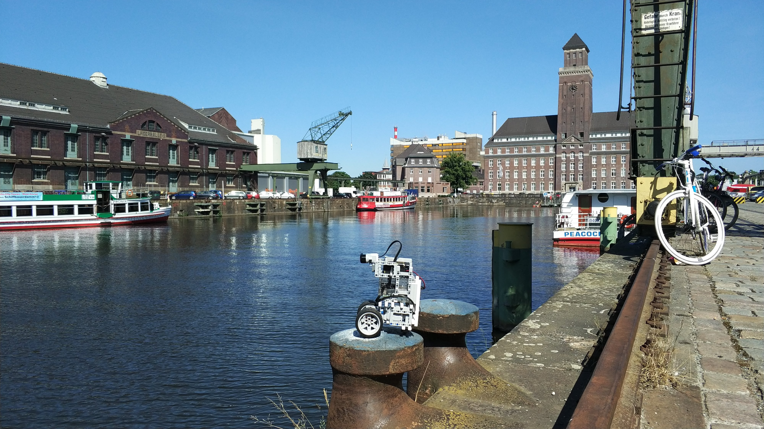
Antti:
The Anti-social Robot

Slide 2
As you may know, Futurice has a robotics dedicated team and one of its members is the social robot Momo. Momo has always been known by everyone, it's been even in the press. Always well taken care of, being in the spotlight and enjoying all of the attention.

Slide 3
What no one will tell you is that before Momo there was a prototype. This earlier prototype, a simple but a proud lego-made robot, remained in the shade. Forgotten by the team, decided to change office and moved to Berlin. We don't have a robotics team but we do have an awesome group of people who welcomed Antti with open arms.

Slide 4
You should know Antti is very different from Momo, it is actually the opposite. It's small, not that good-looking and it doesn't speak. Hugs don't work either. Not only it doesn't like to hang out with people but also tries to avoid them. And I say try because we didn't have enough time to teach Antti a better algorithm for that.

Slide 5
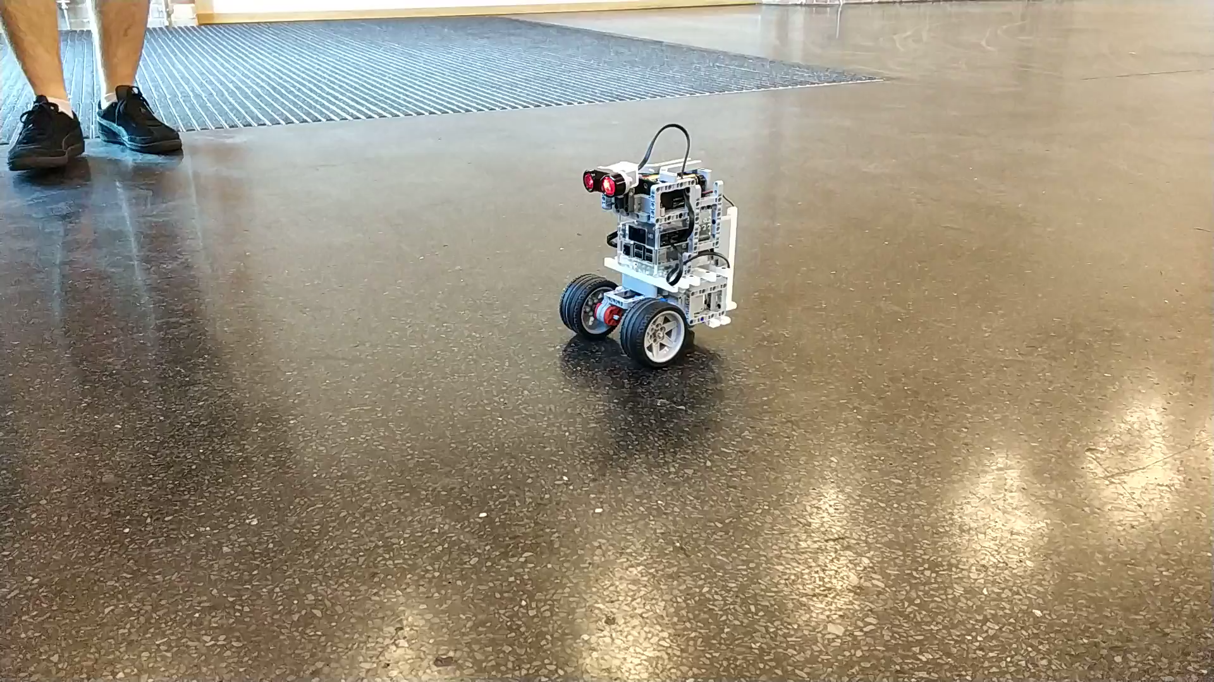

Slide 6
Thank you!

